Slide 1
Digital Dynamo:
Unleashing the Power of Digital Marketing
Author partner: IHF asbl
MICRO 2 – Enhancing Digital Entrepreneurship of Micro Enterprises in Rural Areas in a Post Pandemic World
2022-1-IE01-KA220-VET-000088074

Slide 2
Objectives and Goals
At the end of this module, you will be able to:
DIGITAL MARKETING
Understand the core principles and components of digital marketing
Explore the functions of a comprehensive digital marketing plan aligned with business objective
Implement strategies for lead generation and optimise conversion rates
DIGITAL COMMUNICATION AND INTERACTION
Comprehend the role of digital communication in marketing and brand building
Choose the right social media platforms and tailor strategies accordingly
Develop and implement effective editorial plans for content strategy

Slide 3
Index
UNIT 1: Mastering Digital Marketing Strategies
UNIT 2: Digital Communication and Interaction
1.1 Introduction to Digital Marketing
1.3 Lead Generation Strategies
1.4 Conversion Optimisation
1.5 Customer Retention in the Digital Age
2.1 Introduction to Digital Communication
2.4 Crafting an Effective Editorial Plan
2.5 Integrating Digital Marketing and Communication Strategies
1.6 A Practical Example for Building an Online Presence: Google Business Profile
1.2 Developing a Digital Marketing Plan
2.3 Choosing the Right Social Media Platforms
2.2 Interactive Communication Strategies

Slide 4
Unit 1: Mastering Digital Marketing Strategies
1.1 Introduction to Digital Marketing (1)
Digital Marketing utilises digital channels and tools such as the internet, mobile devices, social media and other digital means to promote brands and related goods – products and services. Unlike and beside conventional marketing, digital marketing offers a unique set of tools, initiatives and opportunities that are exclusive to the online environment.
Although in the early days of its popularity it might have been thought that digital marketing was only an online projection of traditional marketing, digital marketing is now acknowledged as an independent discipline with distinctive features and practices.
Key and characteristics aspects of digital marketing:
Branding: Digital platforms provide an excellent opportunity to build and enhance brand image and identity
Comprehensive Approach: Share of links enables a wider and more customised approach to the target audience
Global Reach: Unlike traditional marketing, digital strategies enable businesses, including those in rural areas, to reach a global audience, breaking geographical barriers

Slide 5
Unit 1: Mastering Digital Marketing Strategies
1.1 Introduction to Digital Marketing (1)
Personalisation: Digital marketing allows businesses to tailor content and interactions based on individual preferences and behaviours
User-Friendly Design and Functionality: Simple and user-friendly platforms contribute to a positive user experience (UX/UI)
Interactive Engagement: Digital environment allows users to actively react and engage with brands, fostering a positive brand experience
Community: Again, internet facilitates strong connections between organisations and their audiences
Visual Storytelling: Various image- and video-based tools enrich the overall brand and related product communication
Virality: Interconnectedness on the internet allows for a possible exponential expansion and sharing of valuable content
Performance Analytics: Online platforms and tools offer tracking and data analytics options, allowing for comprehensive assessment of strategies and campaign performance

Slide 6
Unit 1: Mastering Digital Marketing Strategies
1.2 Developing a Digital Marketing Plan (1)
A Digital Marketing Plan represents a strategic document outlining and organisation’s objectives and the related strategies to achieve them in terms of digital marketing and communication. It encompasses roles, responsibilities, timelines and monitoring tools for an effective implementation and evaluation of digital marketing strategies.
While sharing similarities with the traditional marketing plan, a digital marketing plan distinguishes itself operationally. It enables real-time measurement and the formulation of a flexible short-term strategy, emphasising an iterative process between action and control.
This operational difference stems from the ease with which digital marketing enables continuous evaluation of strategies through the analysis of audience interactions and reactions. The direct relationship with the audience eliminates the need to wait for the results of sales of products or services, moving towards a continuous evaluation rather than an after-the-fact one.
In other words, the focus shifted…
…from final evaluation → to Ongoing Assessment

Slide 7
Unit 1: Mastering Digital Marketing Strategies
1.2 Developing a Digital Marketing Plan (2)
Key steps for the development of a digital marketing plan:
Goal Setting
Strategy Formulation
Tactical Planning
Ongoing Assessment
Analysis Phase
Organisational Foundations (mission, vision, values)
SWOT Analysis (strengths, weaknesses, threats, opportunities)
Online Presence and Geographical Impact Analysis
Segment and Target Audience Definition
S.M.A.R.T. Criteria Alignment (specific, measurable, assignable, realistic, time-related)
Flexibility and Adaptability
A.I.D.A. Model Incorporation (Awareness, Interest, Desire, Action)
Tools and Strategies
Task Scheduling
Time Scheduling
Roles and Responsibilities Allocation
Resources Allocation
KPIs
Audience Interaction and Feedback Systems
Data Analytics Criteria
Monitoring Tools

Slide 8
Unit 1: Mastering Digital Marketing Strategies
1.3 Lead Generation Strategies (1)
Introductive overview: Lead Generation serves as the key starting point for engaging with the audience in their customer journey. It initiates the process of connecting with potential customers and forms the foundation for a comprehensive digital marketing strategy. In the upcoming sections, the subsequent phases will be explored: conversion and retention.
Specifically, lead generation strategy represents the first contact with potential customers through the involvement of meticulous acquisition of their contact data and details. When well-structured, lead generation offers several advantages:
Filling the sales pipeline with potential leads
Establishing and leveraging an email distribution list
Identifying high-quality prospects for targeted marketing and sales efforts
Collecting and analysing data to glean valuable insights into the demographic traits, preferences, and behaviour of the target
Conversion
Retention
Lead Generation

Slide 9
Unit 1: Mastering Digital Marketing Strategies
1.3 Lead Generation Strategies (2)
Here are effective techniques to incorporate into your lead generation strategy:
Landing Pages: Design effective landing pages, ensuring they are designed to seamlessly convert prospects into leads
Forms: Implement streamlined lead generation forms to collect crucial prospect information efficiently
Quality Content: Develop craft high-quality, relevant content that aligns with your business expertise and brand image, capturing the interest of your target audience
Live Chat or Chatbot: Integrate live chat or chatbot functionality to facilitate immediate interaction, providing assistance and addressing queries promptly
Advertisements (Ads): Advertise your brand to broaden your reach and capture the attention of potential leads
Contest / Giveaway / Referral Programme: Create initiatives that aim at broad participation by offering a reward in exchange for data and leads
Reviews: Actively stimulate and encourage the publication of positive reviews, as they play a pivotal role in building credibility
Remarketing: Employ strategies to re-engage users who have previously visited your website or social media, converting them into leads

Slide 10
Unit 1: Mastering Digital Marketing Strategies
1.4 Conversion Optimisation
Once potential customers have been identified and engaged, the focus shifts to systematically guiding them towards desired actions, such as become leads or making a purchase (buyers). This critical phase, known as the Conversion Phase, ensures that the efforts invested in marketing and attracting prospects translate into concrete interactions and tangible outcomes, contributing to business growth and success.
To enhance conversions, a structured conversion research process is essential. This process identifies existing issues, their nature, and the rationale for addressing them.
Conversion Rate Optimisation (CRO):
Definition: A systematic approach to maximise the percentage of visitors on a business website accomplishing a specific goal
Benefits: Ensures the website is visually appealing, user-friendly, and tailored to the needs of customers
Result: Increased likelihood of converting engaged prospects into valuable leads or customers
In the realm of conversion optimisation, businesses refine their strategies to create a seamless journey from initial engagement to meaningful customer actions.

Slide 11
Unit 1: Mastering Digital Marketing Strategies
1.5 Customer Retention in the Digital Age (1)
Customer Retention goes beyond merely keeping customers close, it is about cultivating lasting relationships to transform customers into steadfast brand advocates – a sort of brand ambassadors.
Key factors influencing customer retention:
Psychological Foundations: Retention skills delve into psychology, akin to unravelling the secrets of enduring relationships. This involves understanding the intricacies of human behaviour, emotions, and perceptions
Emotional Bonds: Successful retention hinges on establishing emotional connections with customers. Recognising and catering to their emotional needs fosters loyalty and long-term commitment
Behavioural Analysis: By dissecting the psychological motivations behind customer loyalty, businesses gain insights into the driving forces that nurture loyalty

Slide 12
Unit 1: Mastering Digital Marketing Strategies
1.5 Customer Retention in the Digital Age (2)
Strategies for Customer Retention:
Personalised Engagement: Tailoring interactions based on individual preferences and behaviours
Effective Communication: Regular and meaningful communication to stay connected and address customer concerns
Loyalty Programmes: Incentivising repeat business through rewards, discounts, or exclusive offers
Feedback Loop: Encouraging customer feedback and using it to enhance products or services
Community Building: Creating a sense of belonging and community around the brand
Focus on Microenterprises in Rural Areas: In this context, a retained customer not only ensures repeat business but also transforms them into potential local brand ambassadors. This local influence, coupled with digital strategies like online reviews, allows rural businesses to extend their impact beyond local boundaries. Customer retention thus becomes a dual strategy, solidifying the business within the local community while leveraging the digital space to reach a wider audience through the advocacy of retained customers.

Slide 13
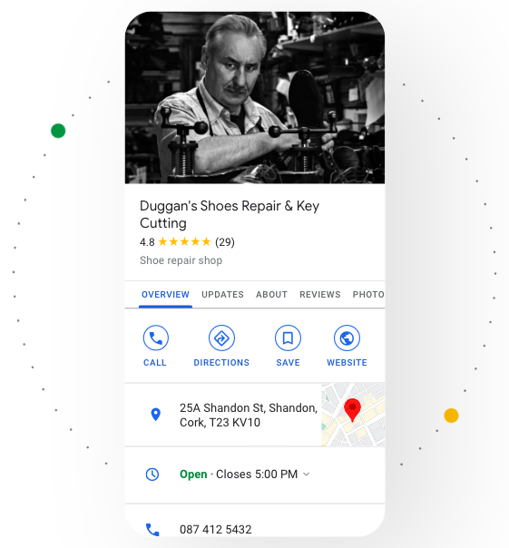
Unit 1: Mastering Digital Marketing Strategies
1.6 A Practical Example for Building an Online Presence: Google Business Profile
“Stand out on Google with a Business Profile”
Google Business Profile is a powerful tool for establishing and enhancing the business’ online presence. It serves as a virtual storefront, providing essential information (name, address, number, directions, photos, opening hours, website, reviews, etc.) about a business to potential consumers.
How Google Business Profile Benefits Rural Microenterprises:
Local Discoverability: People in the vicinity can easily find a business when searching for relevant products or services
Community Connection: Engaging with customers through Google Business Profile builds a sense of community support, vital for microenterprises in rural settings
Mobile Accessibility: Many users in rural areas rely on mobile devices. Google Business Profile ensures a business is accessible to them, even in areas with limited online resources
Source: Google Business Profile – Overview

Slide 14
Unit 2: Digital Communication and Interaction
2.1 Introduction to Digital Communication
Digital Communication acts as the conduit for the seamless exchange of data and information facilitated by digital technologies and platforms. This enables real-time interaction, instant messaging, video conferencing, and the seamless sharing of multimedia content across vast distances.
Critical elements of digital communication include instantaneous interaction, seamless multimedia integration, a harmonious blend of both asynchronous and synchronous communication, heightened accessibility and convenience, collaborative co-creation, meticulous data preservation and archiving, scalable reach, a global footprint, and seamless integration with other cutting-edge technologies. Together, these elements form the pillars of a robust digital communication framework.
Focus on Microenterprises in Rural Areas: Digital communication represents a precious tool to overcome geographical barriers and foster community engagement. Microenterprises, often situated in rural settings, can utilise digital platforms to maintain connections with their local (and not) customer base.
Imagine a local artisan in a rural area using social media and digital communication to showcase their traditional craftsmanship through multimedia content. This not only preserves the cultural heritage of the community but also opens doors for global appreciation and market.
Digital communication enables microenterprises to not only stay connected locally but also expand their reach and visibility on a broader scale.

Slide 15
Unit 2: Digital Communication and Interaction
2.2 Interactive Communication Strategies (1)
A comprehensive digital communication strategy entails careful planning for online communication, emphasising the dynamic interplay between two key elements:
Content / Product: This encompasses the core of the communication, e.g. incorporating persuasive texts, photos, videos, articles, webinars, e-books, podcasts, as well as showcasing products and services, etc.
Digital Channels: These serve as the tools utilised to share and promote the content or product, ensuring effective reach
An effective strategy not only allows to reach the audience but also fosters interaction with them, employing the methodology of interactive communication.
Interactive Communication, facilitated through digital tools and technology, serves as a mechanism for businesses to establish seamless and engaging connections with their audience. It involves one-on-one conversations, distinguishing itself from traditional communication by creating a feedback loop, making it exceptionally effective.

Slide 16
Unit 2: Digital Communication and Interaction
2.2 Interactive Communication Strategies (2)
Incorporating interactive communication within the digital strategy involves implementing dynamic strategies, such as:
Social Media Engagement: Actively participating and engaging with the audience on various social media platforms
Instant and Direct Messages: Facilitating real or near-real-time interaction for swift information sharing
Interactive Live Chat and Chatbots: Leveraging pre-made scripts, these prove invaluable in guiding web visitors to the specific pages or information they seek
Live and Virtual Events: Hosting live or online events to share knowledge, showcase products, and connect with a wider audience
Surveys and Polls: Seeking feedback through interactive surveys or polls to understand customer preferences and tailor communication accordingly
Email Marketing Campaigns: Implementing personalised and targeted email campaigns to maintain regular communication and provide valuable content to the audience

Slide 17
Unit 2: Digital Communication and Interaction
2.3 Choosing the Right Social Media Platform (1)
Focusing on Social Media, here are key steps to guide a business on how to choose the right social media platform:
Identification of Target Audience: Understanding the demographic and psychographic details of the target audience is essential. This knowledge shapes the type of content and dictates the most effective platform for engagement
Analysis of Different Social Media Platforms: Once the target audience is identified, businesses should evaluate platforms based on demographics, engagement levels, content formats, copywriting styles, and advertising options. Examples include:
Facebook: Widely used with diverse demographics; suitable for visual content and detailed copy
Instagram: Appeals to a younger audience; highly visual platform, ideal for image and video-based content
TikTok: Ideal for trend-focuses audience; interesting for promoting brands through creative and entertaining content
X: Fast-paced; suitable for brief, concise updates and real-time engagement
LinkedIn: Professional network; best for B2B engagement and industry-related content
Evaluation of Business Goals: With so many social media platforms available, it can take time to determine which better suite with the achievement of the specific business goals

Slide 18
Unit 2: Digital Communication and Interaction
2.3 Choosing the Right Social Media Platform (2)
Consideration of Resources: A business need to consider its available resources, including:
Budget: Different social media platforms have different maintenance and adv costs
Team size: Focusing on one or two platforms may be more efficient than maintaining a presence on multiple platforms
Skills and expertise of the team: Evaluating which platforms align with their strengths, ensuring optimal content creation and engagement
Time and effort: Prioritising the right social media platforms allows to maximise the return of investment
Determination of Social Media Strategy: Defining goals, researching competitors, developing content strategies, and implementing a monitoring and measurement system are essential to track and optimize results

Slide 19
Unit 2: Digital Communication and Interaction
2.4 Crafting an Effective Editorial Plan (1)
An Effective Editorial Plan serves as strategic roadmap guiding businesses toward successful digital marketing and communication. This strategic document not only defines the content to be published online but also orchestrates a cohesive and impactful narrative that resonates with the target audience. Key components are:
Content Strategy:
Audience Persona Development: Understanding the intricacies of the audience to tailor content that meets their needs
Keyword Research: Incorporating SEO strategies to enhance content visibility and discoverability
Topic Ideation: Brainstorming and planning content topics that align with audience interests and industry trends
Media and Format Planning:
Visual and Multimedia Integration: Incorporating engaging visuals, videos, and interactive elements
Platform-Specific Adaptation: Tailoring content formats based on the preferences and characteristics of digital platforms
Storytelling Techniques: Utilising narrative strategies to captivate the audience and convey brand messages effectively

Slide 20
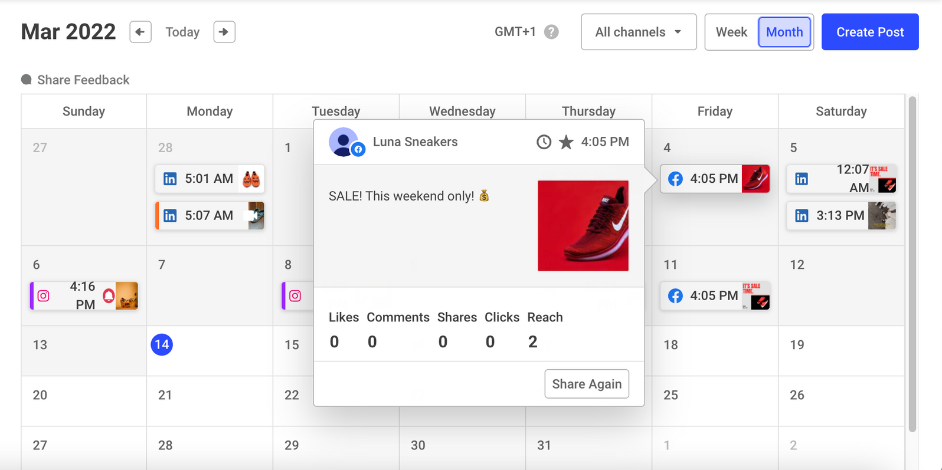
Unit 2: Digital Communication and Interaction
2.4 Crafting an Effective Editorial Plan (2)
Content Calendar and Scheduling:
Timely Planning: Creating a well-structured publishing schedule to ensure a consistent and timely flow of content
Timing Relevance: Choosing the moments when the audience is more active
Seasonal Relevance: Aligning content with relevant seasons, trends, or events for increased impact
Cross-Platform Coordination: Integrating content schedules across various platforms for a unified brand message
Buffer: An Example of Tool for Social Media Content Calendar
Source: Buffer – Why You Need a Social Media Calendar

Slide 21
Unit 2: Digital Communication and Interaction
2.5 Integrating Digital Marketing and Communication Strategies
The integration of digital marketing and communication strategies marks the convergence of two powerful forces that, when harmonised effectively, propel a business toward success in the digital landscape. Key aspects of integration:
Unified Messaging:
Brand Consistency: Consistency of messaging across all digital channels for strengthening brand identity
Cross-Channel Alignment: Marketing and communication messages alignment for a cohesive brand narrative
Data-Driven Decision Making:
Analytics Integration: Data merge from both marketing and communication channels to derive comprehensive insights
Performance Evaluation: Success evaluation of integrated campaigns through collective data metrics
Strategic Content Integration:
Seamless Content Flow: Integration of content between marketing and communication channels to improve storytelling
Adaptation to Platforms: Adaptation of content to the nuances of different platforms while maintaining a unified message

Slide 22
Summing Up
Unit 1: Mastering Digital Marketing Strategies
This unit equips learners with a comprehensive understanding of digital marketing’s distinctive features, including global reach, personalisation, and interactive engagement. From developing strategic digital marketing plans to exploring lead generation and optimising conversions, participants gain insights into creating lasting customer relationships in the digital age. The unit concludes by showcasing the significance of a robust online presence through platforms like Google Business Profile, particularly beneficial for microenterprises in rural areas
Unit 2: Digital Communication and Interaction
Unit 2 delves into the dynamics of digital communication, emphasising real-time interaction, multimedia integration, and scalable reach. Learners explore interactive communication strategies, choose effective social media platforms, and craft editorial plans and content calendar for impactful digital marketing

Slide 23
Self-Assessment Questions
1. What is a key characteristic of digital marketing that differentiates it from traditional marketing? | 2. Why is Lead Generation crucial in the digital marketing process? | 3. In the context of customer retention, what role do emotional bonds play? | 4. What is the primary purpose of an Effective Editorial Plan in digital marketing? | 5. How does Interactive Communication differ from traditional forms?
National reach Fixed and static approach Interactive engagement with users Lack of performance analytics | It is only relevant for large enterprises It fills the sales pipeline with potential leads It primarily focuses on direct sales It has no impact on customer insights | They have no impact on retention They foster loyalty and long-term commitment They are irrelevant in the digital age They only apply to large corporations | Defining content to be published online Managing financial resources Evaluating competitor strategies Conducting market research | It is less effective due to a lack of feedback It does not involve digital tools It creates a feedback loop, making It exceptionally effective It focuses solely on visual content

Slide 24
Thank you!
Continue your training path at https://www.digitalmicro2.eu/

